Slide 1
Data Analytics & Data visualization boot camp – University of Minnesota

Slide 2
Cardiovascular Disease Death Rates Analysys in the United States
By: Julia, Walgama, Meredith, Chelsea

Slide 3
Background
CVD disease (CVD) is one of the most serious health issues and leading cause of sudden death in the worldwide. It is a common issue in both developed countries and developing countries. Risk factors for the CVD basically categorize demographic, socioeconomic, behavioral, environmental, and physiological factors. But there may be some other factors that matter.
There for it is very important to gather and analyze CVD death information to make any decision on minimizing CVD death rates.

Slide 4
Scope of the project
In this project analysis is limited to the counties only in United States of America (USA). Further analysis is limited to the demographic risk factor among various risk factors associated with the CVD death rate.
We pulled our data for this analysis from catalog.data.gov.
Smoking rates
“https://www.lung.org/research/trends-in-lung-disease/tobacco-trends-brief/rates-by-state#item-915365502”

Slide 5
Areas of analysis
Breakdown of the country overall, breakdown of MN Counties
Breakdown of ethnicity
Geographical distribution of CVD death rates
Correlation between CVD death and smoking
Breakdown of CVD death rates and gender

Slide 6
Cleaning the Data
We started cleaning our data by keeping only Age-adjusted and Spatially Smoothed, 3-year Average Rate. We removed the insufficient data, anything that was empty.
We renamed and removed some of the columns that were not needed for the analysis. This was done for easier reading of the data and minimizing the size for the dataset.

Slide 7
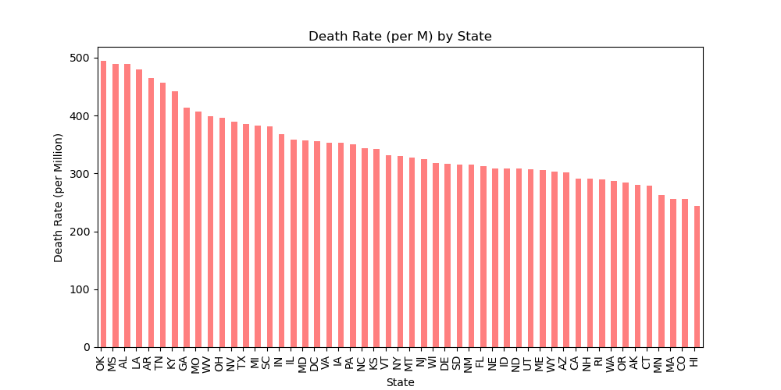
States Breakdown
Questions to be answered what part of MN had the highest rate of death from CV disease and how did MN compare to other states. The country average for death rates from CV was 364, MN is below with an average is 262.
Notes:
In this analysis, we compared the death rates for cardiovascular disease across the states in the United States, and among the counties in the state of Minnesota. When looking at the Death Rate (per M) by State graph, we found Minnesota was in the top 5 (lowest) death rate in the US. The state that had the most deaths due to cardiovascular disease was the state of Oklahoma.

Slide 8
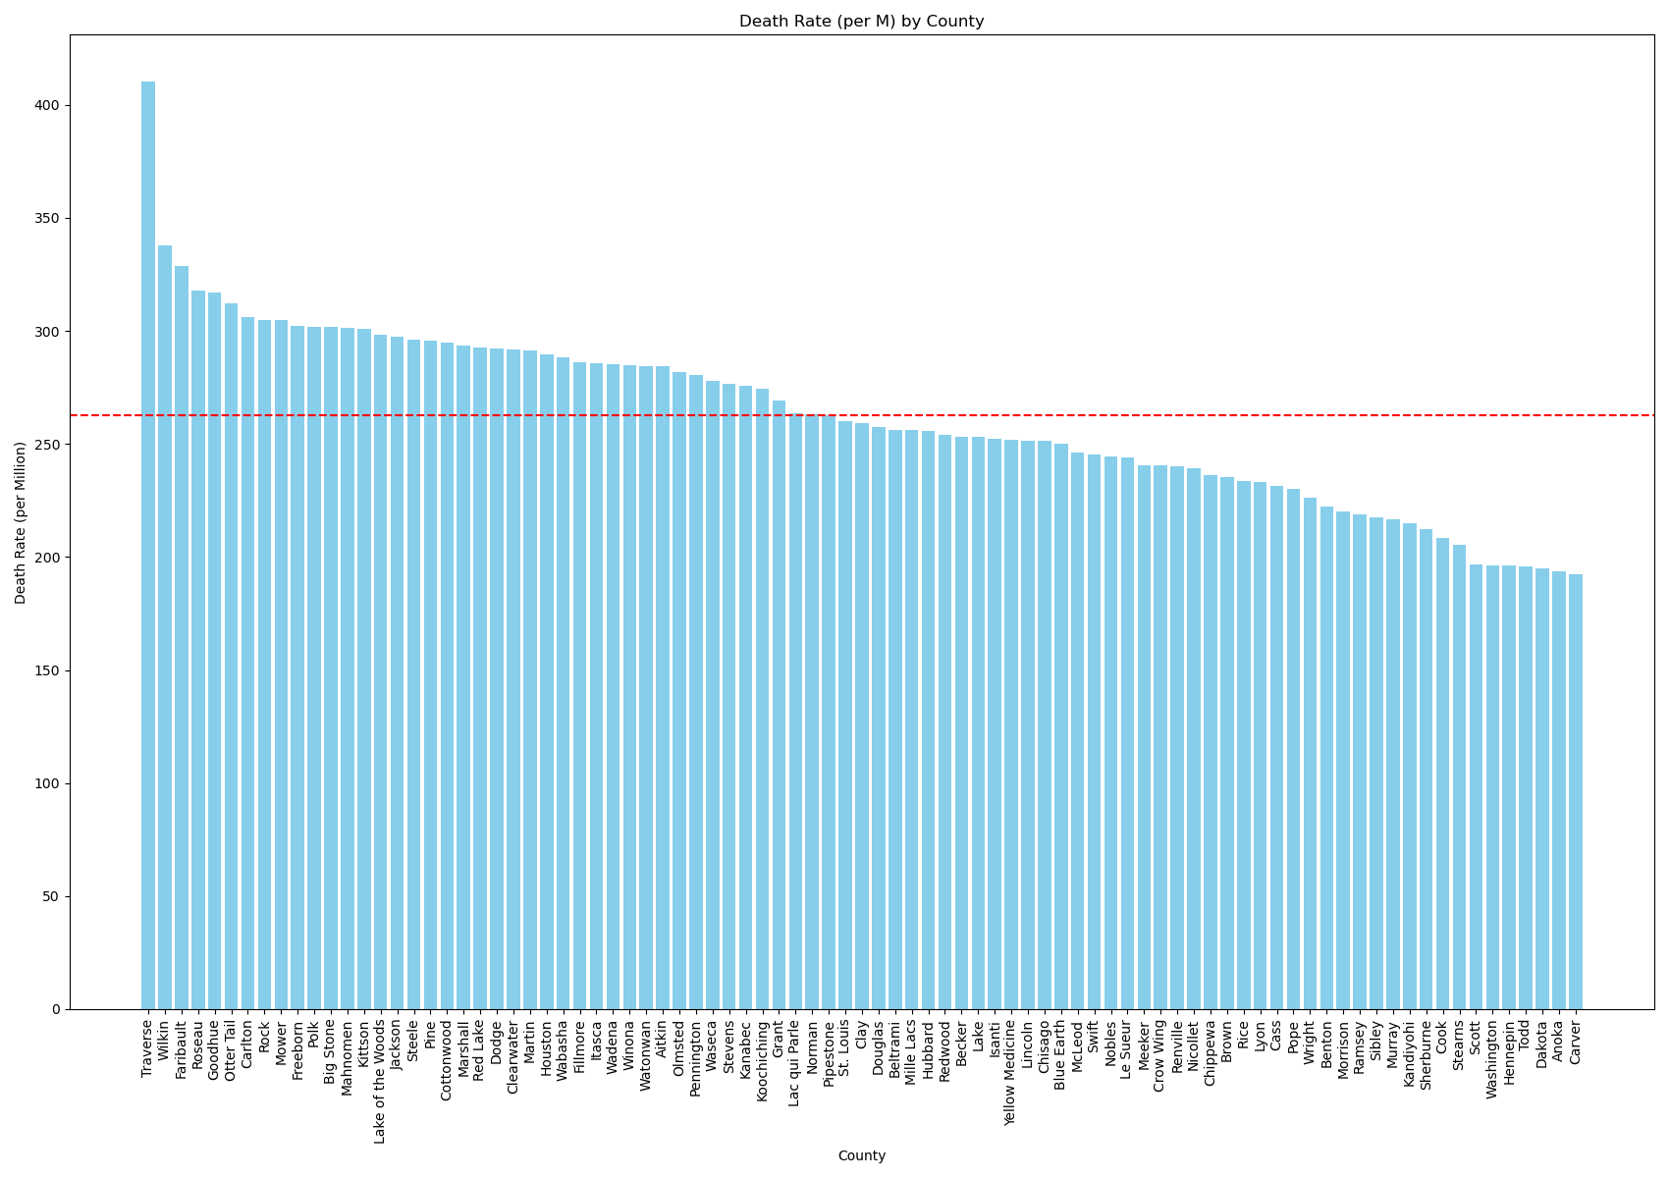
States Breakdown
The red dotted line indicated the average death rate per M in the state of MN. Here we can see where each county falls among the average.
Notes:
-When breaking down the state of MN by county, about half of the counties are below the MN average and half above the MN average line. We found the county of Traverse to be an outlier. It had an approximate date rate of 400+ death rates per million people. The areas surrounding the twin cities metro seem to have lower rates of death due to CV.

Slide 9
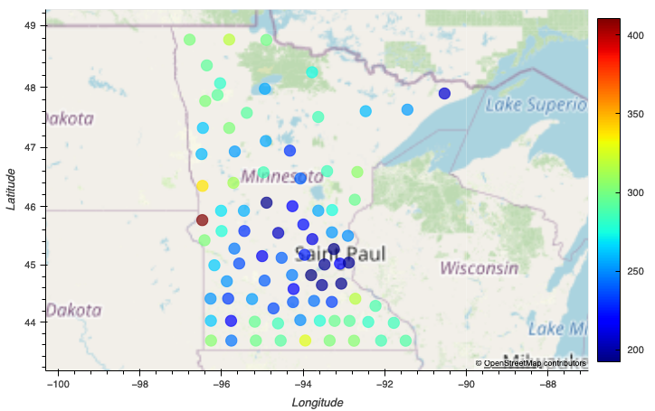
Breakdown of counties in MN
Blue indicates lower death rates of CVD and red indicates higher. The lower rates are mostly centered around the twin cities metro.

Slide 10
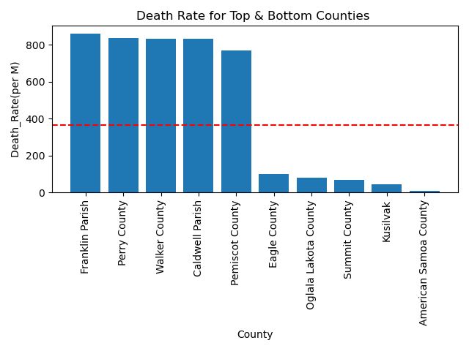
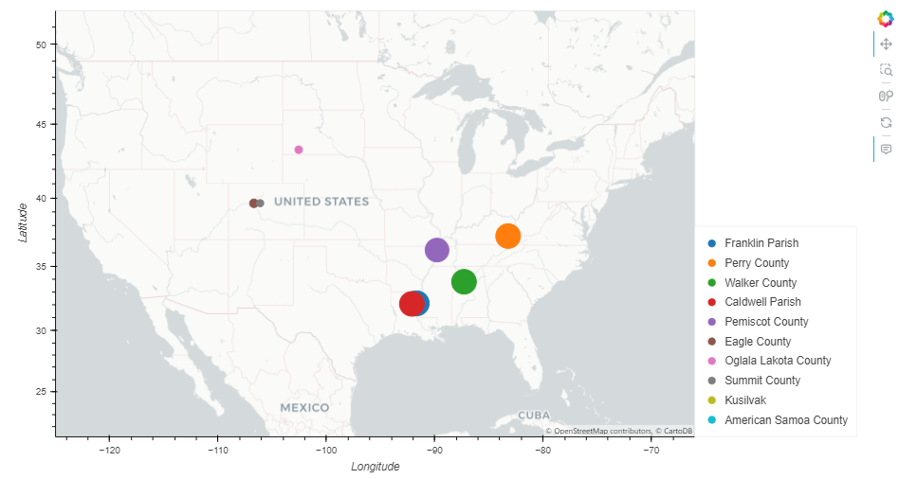
Geographical distribution of CVD death rates
Top and bottom 5 Counties
Geographic area of the top and bottom five

Slide 11
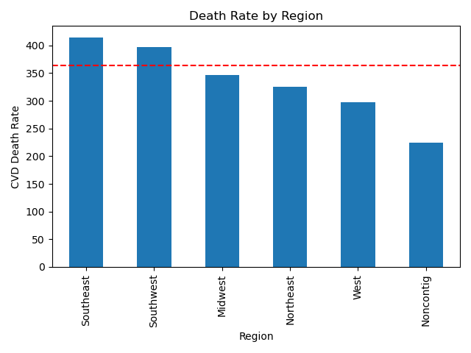
Death rate summary by Regions

Slide 12
Summary of the Geographical analysis of the CVD death rate
When check the top and bottom values of the CVD death rate for all the counties, it can be seen that there are some counties which rates far higher (almost double than the country average) than the country average and some are far below the country average.
When plot these data in a map visual , higher CVD death rates counties are in most southeast region and low rates counties are middle of the country.
Higher CVD death rates can be seen in the south region of the country having average CVD death rate above the country average.¶

Slide 13
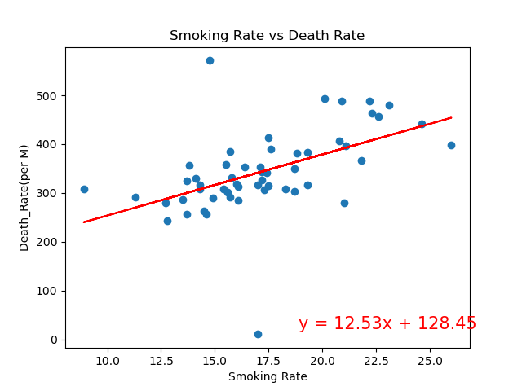

Correlation between CVD death rate and the smoking rate.
In this analysis correlation coefficient (r) values between smoking rate and the CVD death rate is + 0.59.
This means there is a positive relationship between smoking rate and the CVD death rate.¶
But, when you see the r-squared value, it is 0.3475 and means only 34% chance of changing the CVD death rate by changing the smoking rate.

Slide 14
xx%
Use this slide to show a major stat. It can help enforce the presentation’s main message or argument.

Slide 15
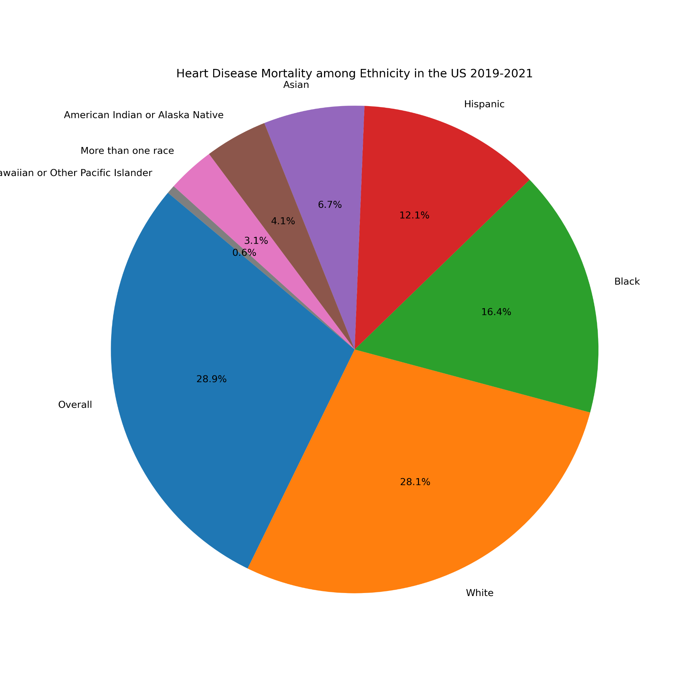
Cardiovascular Disease among Ethnicity

Slide 16
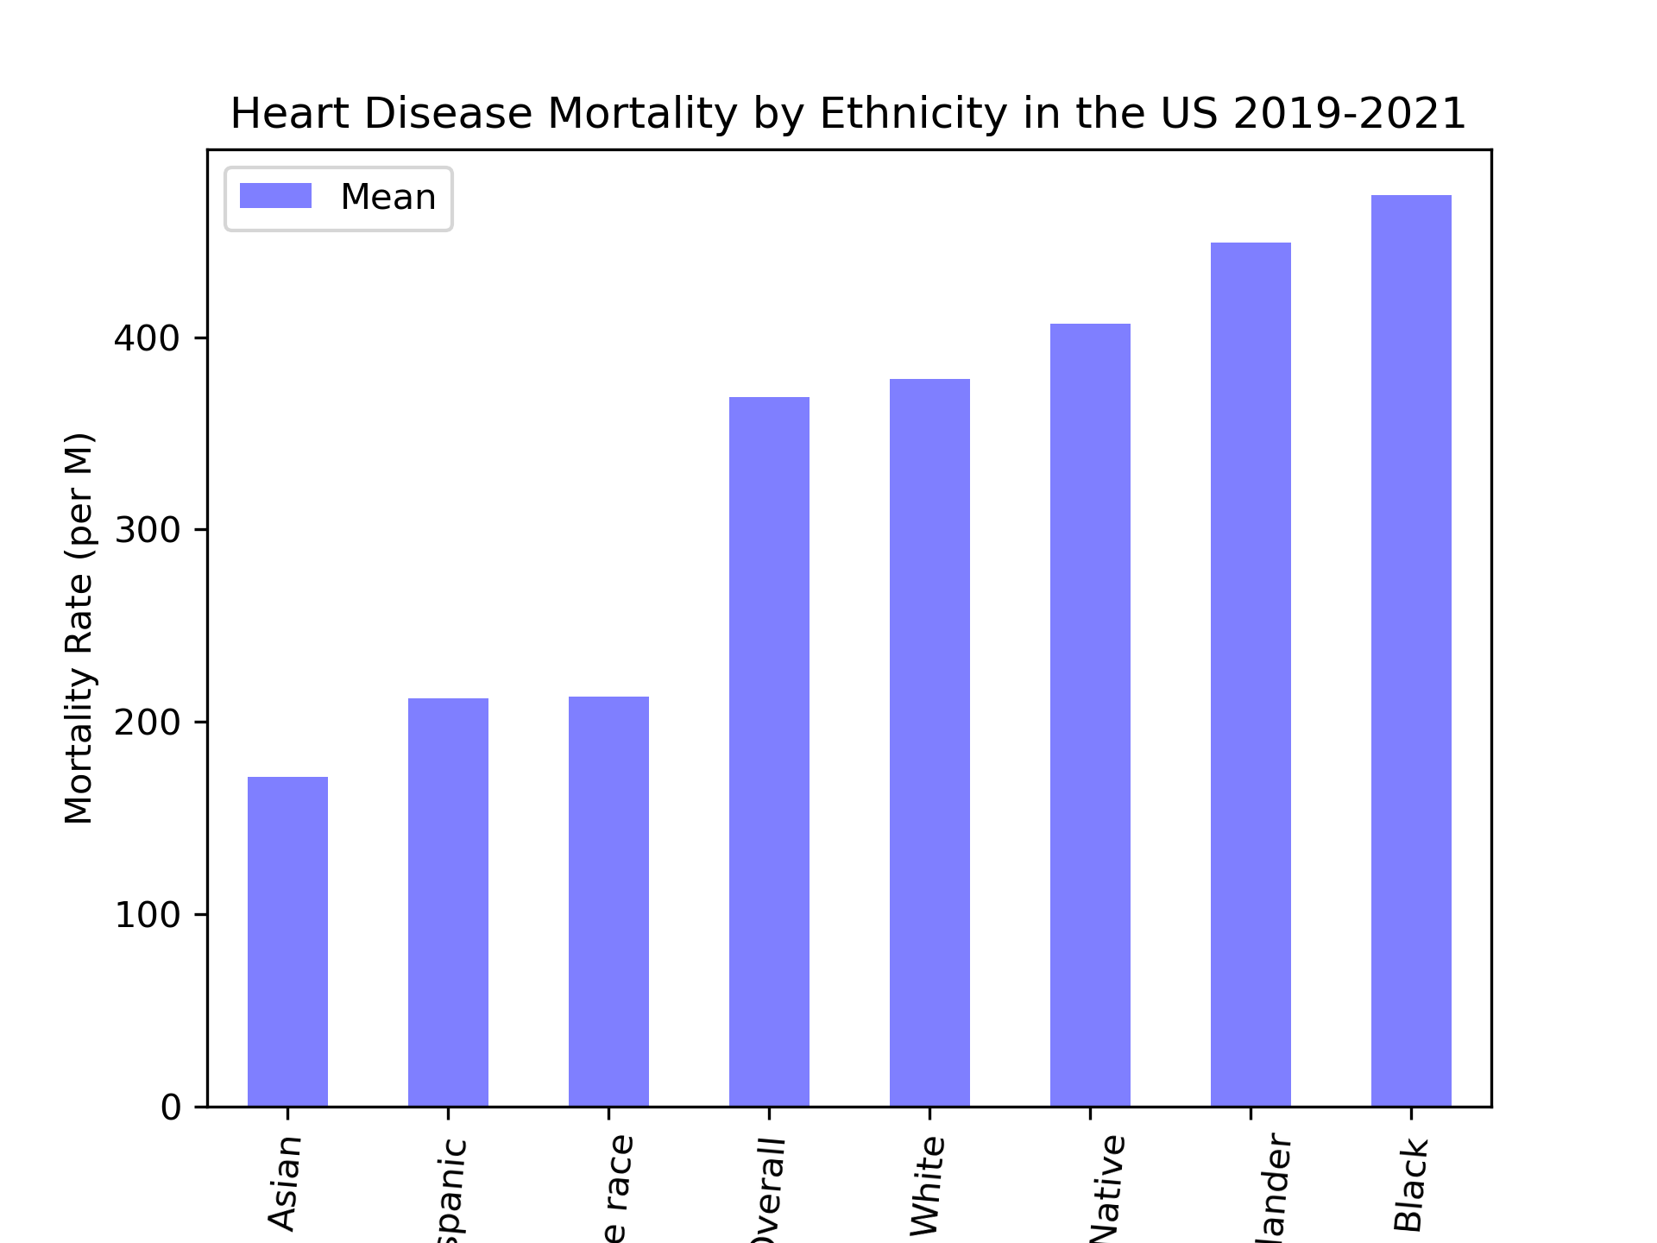

Slide 17

Final point
A one-line description of it

Slide 18
“This is a super-important quote”
- From an expert

Slide 19
This is the most important takeaway that everyone has to remember.

Slide 20

Thanks!
Contact us:
Your Company
123 Your Street
Your City, ST 12345
no_reply@example.com
www.example.com

